Slide 1
ECE 884 Final Project
COVID-19 Analysis using RNN and LSTM
By Sakshi Joshi

Slide 2
Project Dataset
Original dataset –
COVID-19 data on Kaggle from Jan 22nd to May 14th
Data – Long format of Confirmed cases and Fatality numbers of 189 countries
Updated Dataset –
COVID-19 JHU data repository from 22nd, 2020 till today
Data – Time series format of Confirmed cases and Fatality numbers of 189 countries (https://github.com/CSSEGISandData/COVID-19/tree/master/csse_covid_19_data/csse_covid_19_time_series)

Slide 3
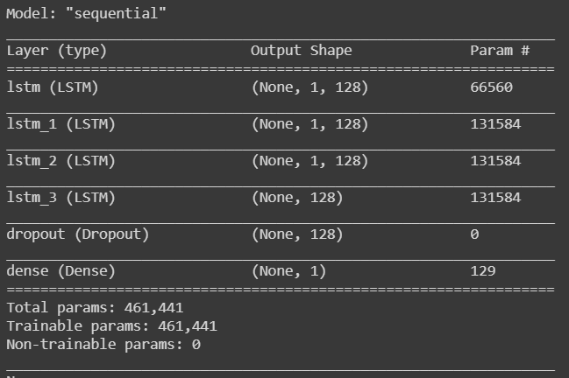
Baseline Model
Scaling – MinMaxScaler()
Optimizer – Adam
Loss – mean_squared_error
Dropout rate – 0.2
Batch size – 16

Slide 4
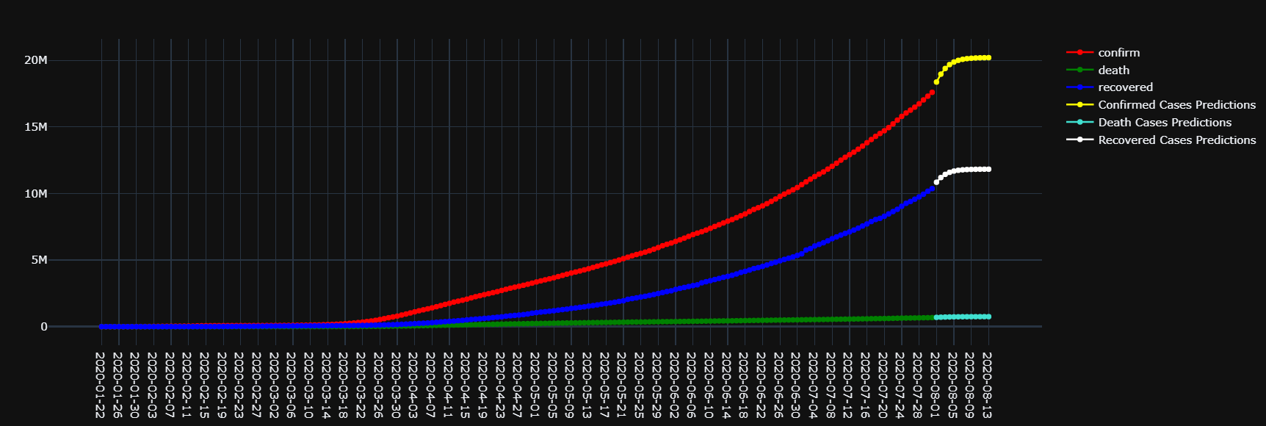
Model Outcome

Slide 5
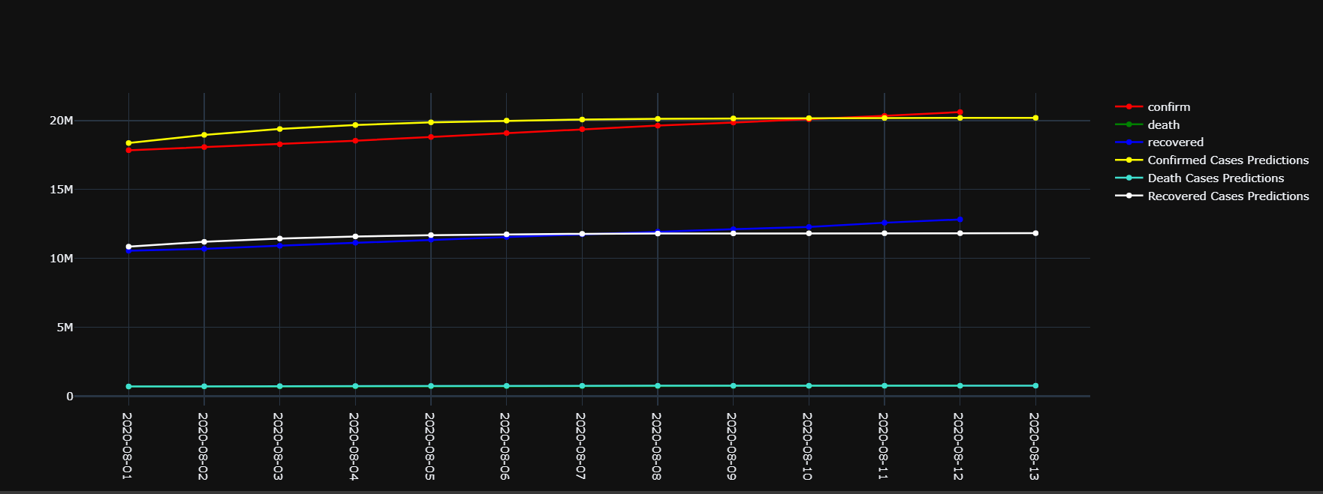
Model Outcome

Slide 6
Project Dataset
Original dataset –
COVID-19 data on Kaggle from Jan 22nd to May 14th
Updated Dataset –
COVID-19 JHU data repository from 22nd, 2020 till today
Data – Time series format of Confirmed cases and Fatality numbers of 189 countries (https://github.com/CSSEGISandData/COVID-19/tree/master/csse_covid_19_data/csse_covid_19_time_series)
External Dataset –
Oxford Covid-19 Government Response Tracker (161 countries) (https://github.com/OxCGRT/covid-policy-tracker)
Population density per country (159 counties) (https://github.com/owid/covid-19-data)

Slide 7

Data Preparation
External government response data –
Indicators(17) – School_closing, workplace_closing, cancel_public_events, restrictions_on_gatherings, close_public_transport, stay_at_home_order, restrictions_on_internal_movement, international_travel_control, public_information_campaign
Stringency_index – time series data of index calculated as follows,
Population Density –
Population density of 156 countries as of 2019

Slide 8
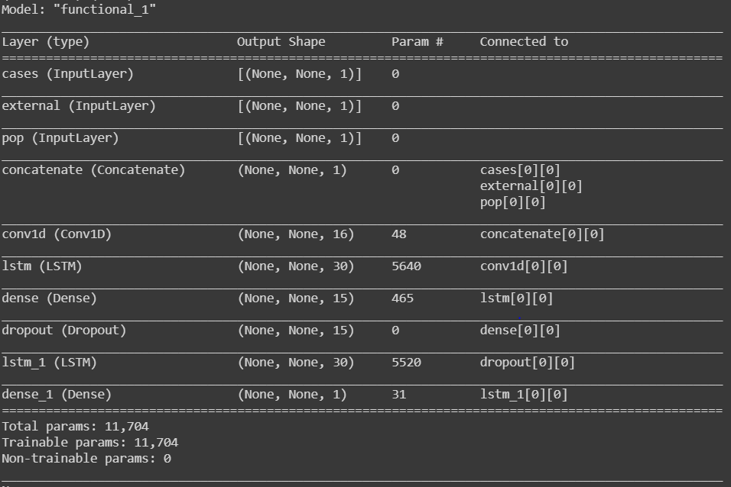
Model
Scaling – RobustScaler()
Optimizer – Adadelta (lr =0.001)
Loss – MeanSquaredLogarithmicError()
Activation – relu
Batch size – 10

Slide 9
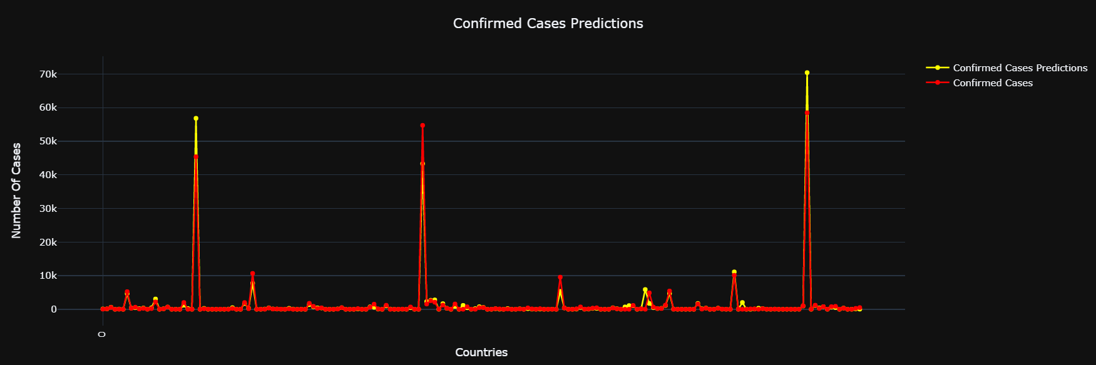
Model Outcome

Slide 10
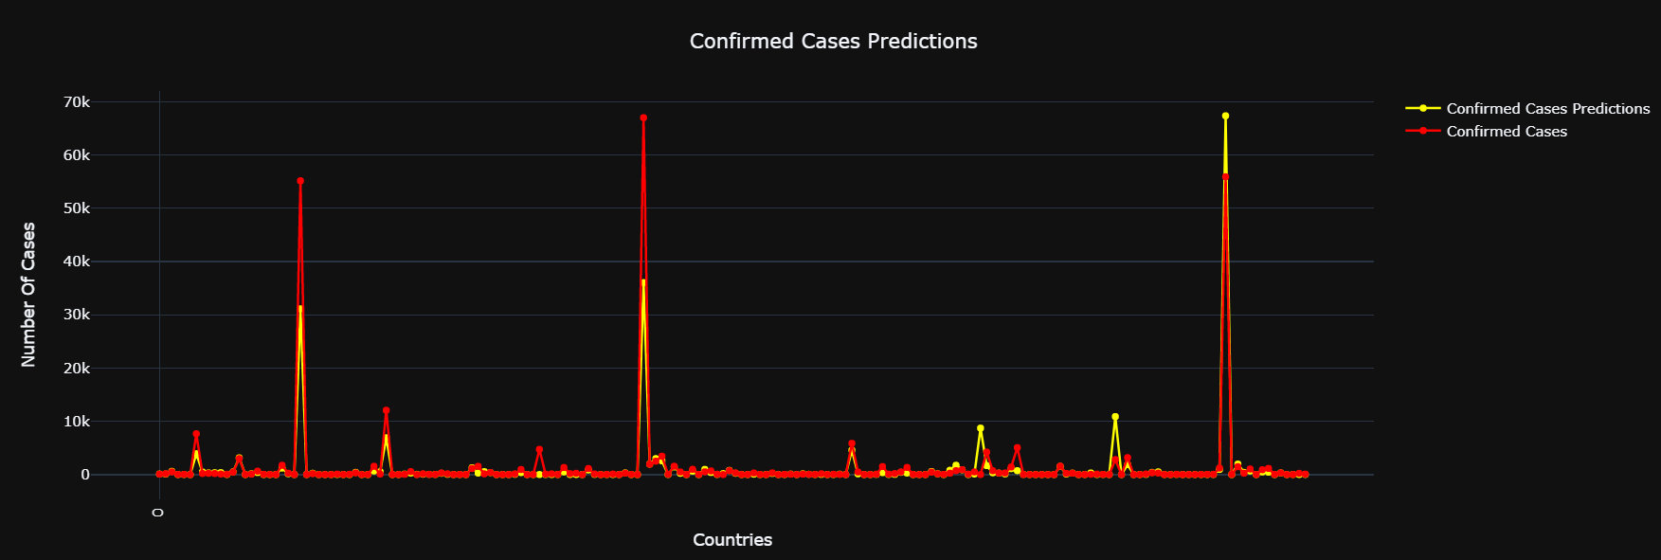
Model Outcome

Slide 11
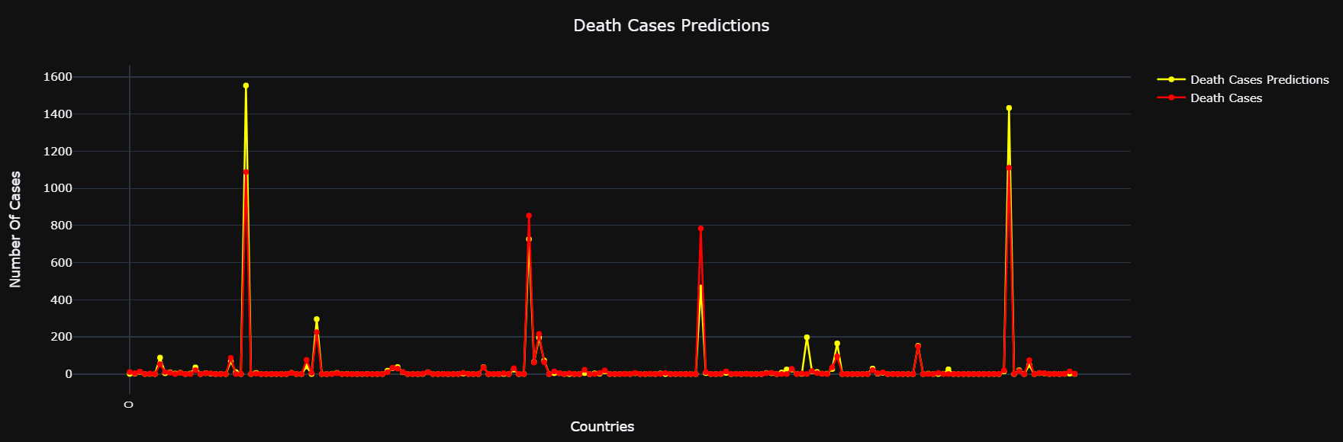
Model Outcome

Slide 12
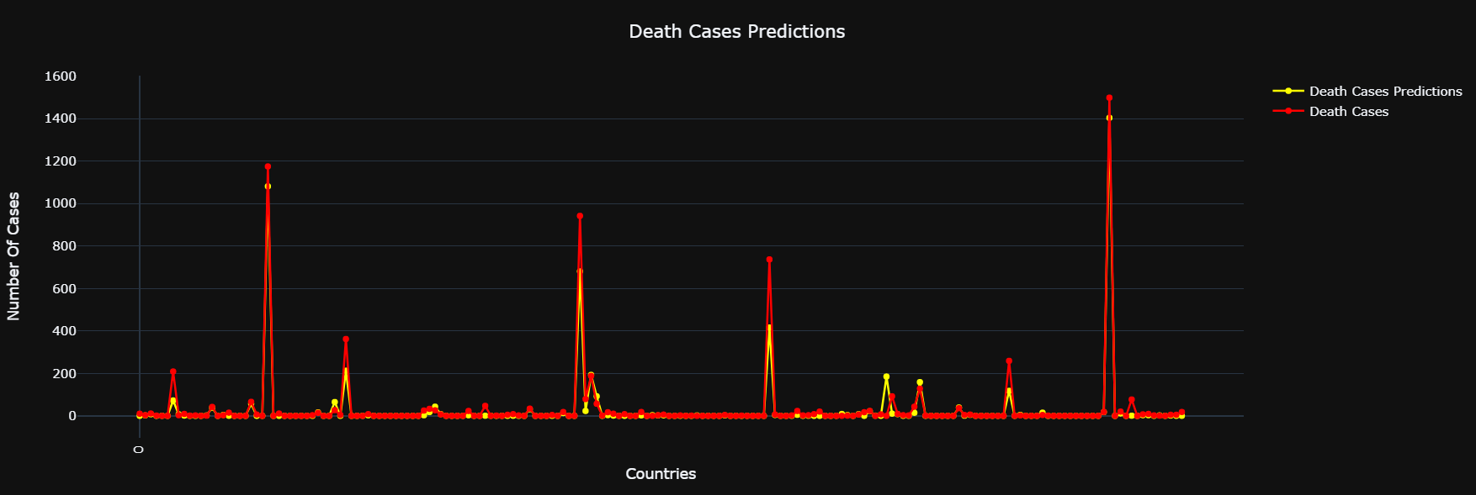
Model Outcome

Slide 13
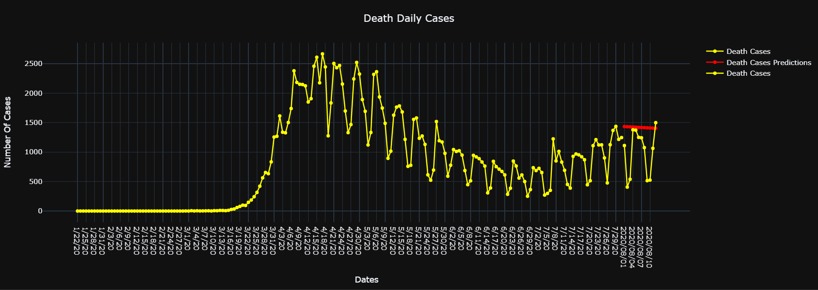
Model Outcome

Slide 14
Extensions
Learned multi input layer LSTM & recurrent prediction
Improve model in future by increasing time step
Predict government responses along with COVID-19 cases
Include more indicators such as population demographics(age, lifestyle, etc.), country health sector management, etc.

Slide 15
Thank You!
Recommendations?
By Sakshi Joshi

